Slide 1

Cinepolis
By: Nicole Andermanis and William Chen

Slide 2

What is Cinepolis?
Cinepolis is a movie theater chain based out of Morelia, Mexico
Cinepolis is the largest movie theater chain in Mexico with 427 locations in 97 cities throughout the country
There are Cinepolis movie theaters in the USA as well; in California, Connecticut, Florida, Maryland, New Jersey, New York, Ohio, and Texas
Cinepolis was founded by Enrique Ramírez Miguel, with the current CEO being Alejandro Ramirez Magana

Slide 3
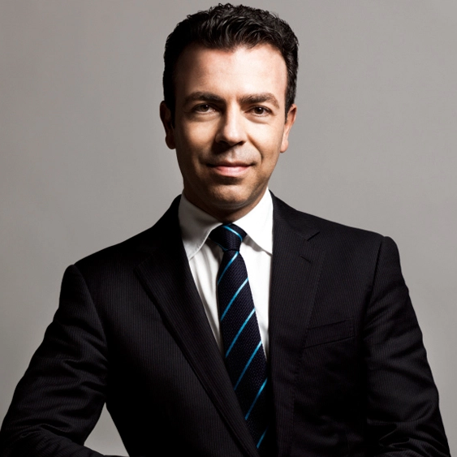
Alejandro Ramirez
In high school, Ramirez organized debate groups to tackle problems such as poverty and discrimination
Engaged with society by visiting senior homes, orphanages, and engaged with residents
BA in economics from Harvard University and MSc in developmental economics from the University of Oxford
Committed to fight social issues

Slide 4
Leadership and management styles
Employees ranked Alejandro a 79/100, which according to Comparably was ranked an A+
The female employees ranked Alejandro higher than the male employees
The sales department ranked Alejandro the lowest
The operations department ranked Alejandro the highest

Slide 5


Alejandro's effect on Cinepolis
By 2011, Cinepolis sustained eight years of revenue growth over 100%
Launched Cinepolis Junior (later changed to MiCine)
Emphasized listening to customer needs
Removed common practices such as intermissions during movie screenings
Started social initiatives to achieve social impacts in 2006
Cinepolis Foundation (financed and coordinated the program "Del amor nace la vista" [Sight is Born out of Love])
Provided access to cataract surgery in low-income communities
"Vamos todos a Cinepolis" (Let's All Go to Cinepolis)
"Ruta Cinepolis"
In the 2010 Haiti earthquake, Cinepolis brought movies to Haiti to help people forget about their troubles and have fun

Slide 6
Who has heard of presumed guilty (Presunto culpable)?

Slide 7

Presumed guilty
Documentary filmed between 2006-2008 by Roberto Hernandez and Layda Negrete
Exposed Mexico's judicial system (guilty until proven innocent)
Antonio Zuniga, a 26-year-old street vendor was accused of killing Juan Reyes in 2005
Held incommunicado for two days without being told the charges against him
Found guilty in a closed-door trial and sentenced to 20 years in jail
Judge knew there was no evidence that linked Zuniga to the crime
According to the documentary, conviction rate in Mexico is 95%, but 92% of verdicts lack evidence

Slide 8
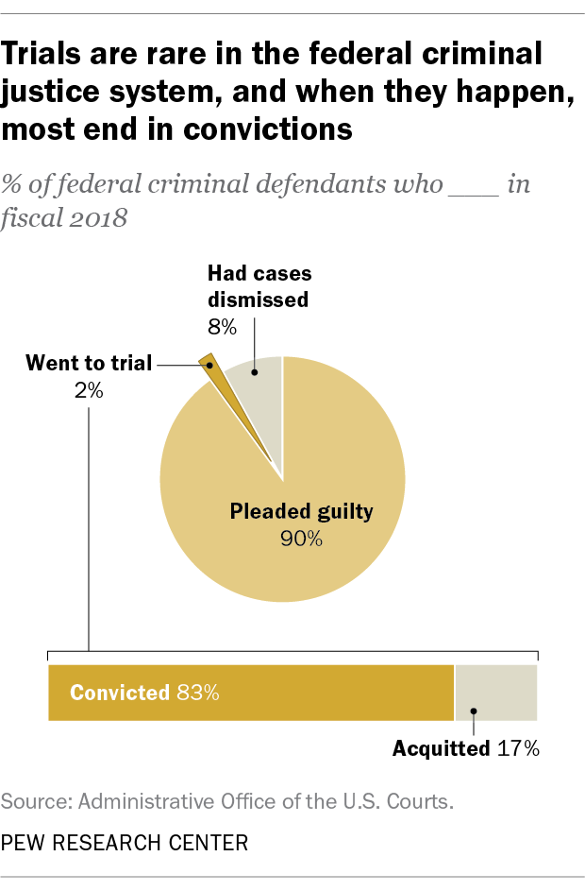
Conviction rate in Mexico vs united states
With the conviction rate of 99.6% in the United States, 4% of that conviction rate results in acquittals, meaning about 95.6% of those who are convicted are found guilty of the crime
This stands out because the conviction rate is astronomically high in the United States as well, and should also be taken into consideration

Slide 9
Should the judicial system be changed? How would you convince the judge to release antonio zuniga?

Slide 10
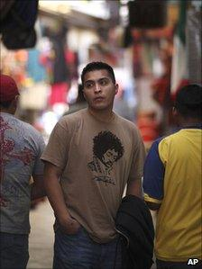
Antonio Zuniga's retrial and presumed guilty
In 2008, Antonio Zuniga had a retrial and was convicted again
Released months after Hernandez and Negrete showed an appeals panel the recorded retrial
Presumed Guilty received many top awards across the world
No Mexican company wanted to distribute the film

Slide 11
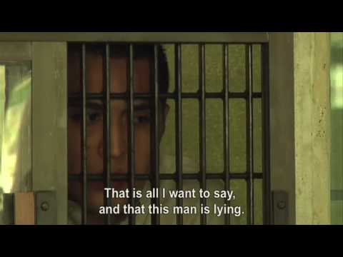
Presumed guilty trailer Warning: Some graphic scenes
Who would show this film? Why would movie theaters not want to show this film?

Slide 12
Alejandro Ramirez and presumed guilty
Theater chains usually did not distribute movies (produced by independent individuals)
Documentaries usually don't do great and have low interest
Alejandro put the trailer for Presumed Guilty across Cinepolis' Mexico locations
Alejandro was moved by the story and was projected to lose $100,000 but didn't lose anything in the end
Legal risks
Political and reputational risks since the film shows a dysfunctional judicial system

Slide 13
ALEJANDRO RAMIREZ AND PRESUMED GUILTY (cont.)
Ramirez was devoted to showing Presumed Guilty
Wanted to donate the profits to Renace, a non-profit organization and wanted to bring changes to the Mexican judicial system
Margarita Zavala, wife of the Mexican president was among the 900 celebrities who attended the gala opening
Documentary ticket sales usually ranged between $8 million and $12 million Mexican dollars
Presumed Guilty sales added up to $80 million Mexican dollars

Slide 14

Presumed guilty's complication
Many argued that the producers took for granted the witness and they should've used more than just the one documentary to prove Antonio's innocence and put the blame on the other actors
Did the filmmakers have the right to film trials?
Were they allowed to show viewers partial evidence? And what is wrong with showing partial evidence?

Slide 15
Order of removal
A witness became upset that his image was used without consent in the film, leading to Judge Blanca Lobo Domínguez ordering suspension of the distribution and promotion of Presumed Guilty
Alejandro Ramírez pushed back on this suspension stating that this is ironic that the movie exposes the justice system for its wrongdoings, yet the movie is becoming another victim of the justice system by not being allowed to be seen by individuals as a powerful movement

Slide 16
What to do now?
The plaintiffs that were pressing charges became interested in a settlement, which would be a lengthy and costly process
Alejandro had to decide if he should pull the movie from Cinepolis theaters, which would then make it impossible to get the movie's powerful message across to the audience
It might sound easy to just edit out the faces of those pressing charges as ruled by Judge Blanca Lobo, but according to Mexican cinematography law, a movie's content cannot be edited

Slide 17
ethics
Judge Blanca Lobo's ruling of editing out the faces of the plaintiffs not only goes against the Mexican cinematography laws, but infringes on the right to information and freedom of speech
If Alejandro Ramírez continued to show the film, it would cost Cinepolis around $4 million dollars per year, meaning this would take up about 1/3 of the company's yearly revenue

Slide 18
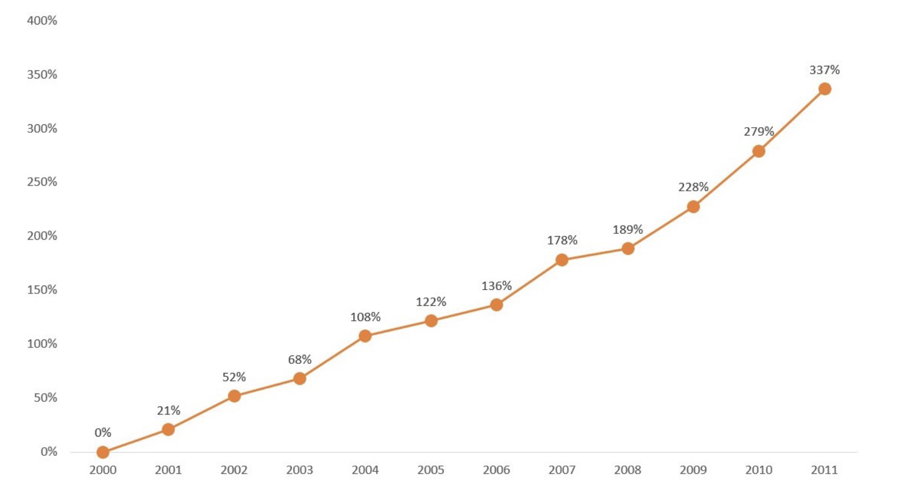
Annual revenue growth
Taken from case study

Slide 19
What would you do?
Would you have continued to show the movie if you were Alejandro Ramírez?
Would you have gone through with the settlement? Or go against Mexican cinematography laws and edit out the plaintiffs?
Do you think Judge Blanca Lobo's suggestion of editing out the faces was a good idea even though it goes against the law and why?

Slide 20
What happened?
Alejandro did not want the movie to be taken down, and he did not want his determination to be halted
This relates to the values of Cinepolis; Passion for results, Integrity, Commitment, Service, Ser Palomita (“be a popcorn”) an expression used to combine values such as being a team player, innovation, creativity and diversity
If he were to just pull the movie, he might of felt as though he was going against the values of the company

Slide 21

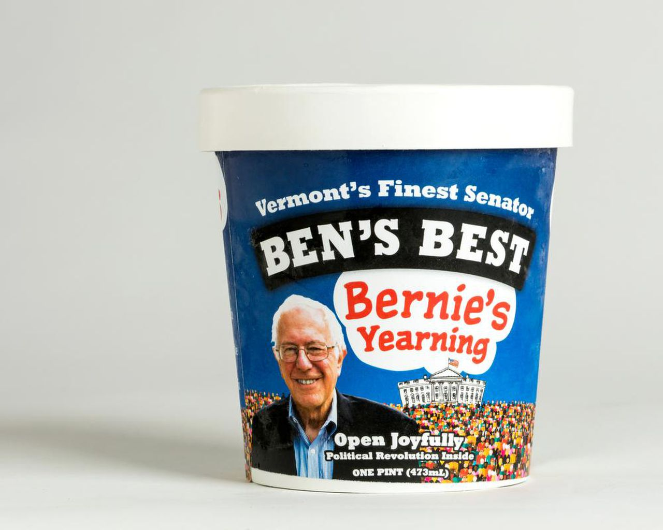
Ben & Jerry's politics
Ben & Jerry is known to take political stances
"We believe that business has a responsibility and a unique opportunity to be a powerful lever of change in the world." - Ben & Jerry's
"No company does progressive politics quite like Ben & Jerry's" - The Atlantic
Voting rights, racial justice, climate change, LGBTQ+

Slide 22
What happened afterwards?
Judge ordered authorities to stop showings and Cinepolis had to comply
Mexico City appeals court overturned this ruling
Violated freedom of information
Showings resumed soon after

Slide 23
References
https://zeevector.com/cinepolis-logo-vector-png/
https://twitter.com/somoscinepolis/status/1114920771934015488?lang=hi
https://logos.fandom.com/wiki/Fundaci%C3%B3n_Cin%C3%A9polis
http://archive.pov.org/presumedguilty/film-description/
https://www.bbc.com/news/world-latin-america-12674150
https://www.amazon.com/Presumed-Guilty-Layda-Negrete/dp/B0071WQ806
https://www.foxnews.com/lifestyle/order-pulling-presumed-guilty-from-theaters-is-reversed
https://www.theatlantic.com/international/archive/2021/07/ben-jerrys-decision-israel-settlements/619537/
https://www.benjerry.com/values/issues-we-care-about
https://www.dairyreporter.com/Article/2018/11/02/We-couldn-t-be-silent-any-longer-Ben-Jerry-s-new-flavor-gets-political
https://www.thestar.com/news/world/2018/09/24/ben-and-jerrys-creating-political-ice-cream-flavours.html
https://www.doarlaw.com/blog/2021/04/what-you-should-know-about-the-federal-governments-conviction-rate/
https://www.comparably.com/companies/cinepolis/leadership
https://www.pewresearch.org/fact-tank/2019/06/11/only-2-of-federal-criminal-defendants-go-to-trial-and-most-who-do-are-found-guilty/

